Slide 1
Agile Software Development (DIT191 / EDA397)
Eric Knauss
<eric.knauss@cse.gu.se>

Slide 2
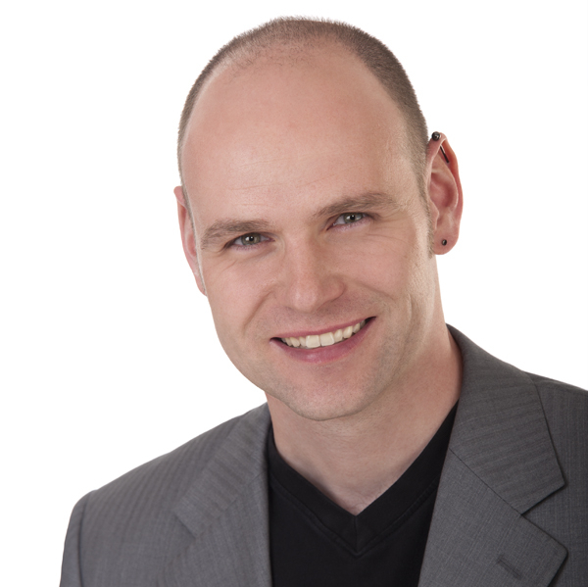
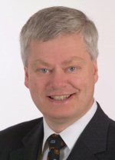
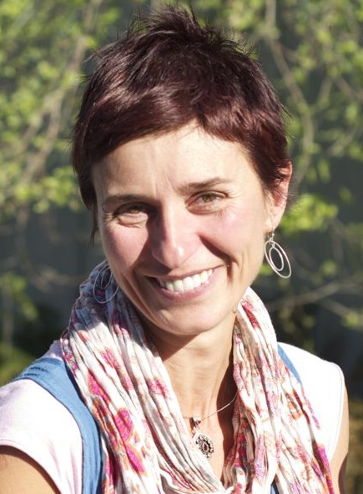
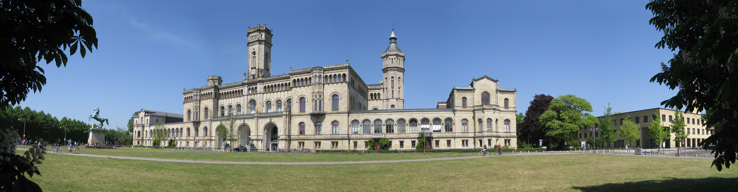







Hi, nice meeting you! (Short CV)
Born in Hattingen, Germany
University in Dortmund and Hanover
PhD in Hanover: Improving Requirements Documentation based on Heuristics and Experience
Postdoc in Hanover: Global Software Development
Postdoc in Victoria BC: RE in Distributed Large- Scale Software Projects
Topics
Requirements Engineering
Agile Methods
RE and Project Management
Experience and Knowledge Management

Slide 3
?
What about you?
Who are you (name, university, programme)?
What would make this course great for you?

Slide 4
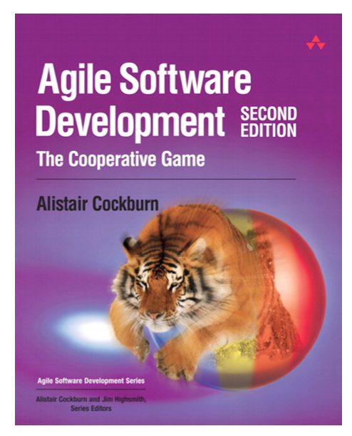
Course setup
Teaching Assistant
Emil Alégroth (emil.alegroth@chalmers.se)
Course representants
In parallel:
PhD course
Course Material
http://oerich.github.io/EDA397/
Cockburn,A., (2009) Agile Software Development, 2ed
Papers

Slide 5
Course setup (Practical details)
Schedule
0-3 lectures per week
0-2 workshops per week
=3 scheduled activities per week
Even if there is no lecture, we will be available and you can (should!) use the rooms/time to work!
Examination
Project (teams)
Final product
Artifacts
Report (Individual)
Experience / Post-Mortem report
Written exam

Slide 6
Project
Develop an Android app for a customer
Work in predetermined teams
You will be assigned teams
You decide about your development methodology
You meet with the customer during course week 2
and get all the details!
We strive to create a realistic scenario/ environment
We rely on a number of real-world services and tools, e.g.
Android (SDK) GitHub / BitBucket ..
How to assign teams? When?

Slide 7
Course setup
Three sprints
Sprint 1: Getting started
Sprint 2: Getting work done
Sprint 3: Theory and advanced concepts

Slide 8
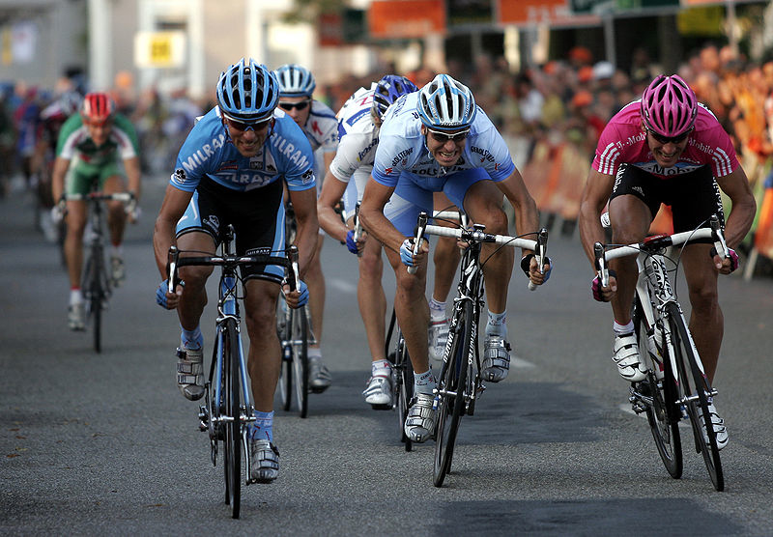
Sprint 1: Getting started
http://commons.wikimedia.org/wiki/File:Sprint_01.jpg

Slide 9
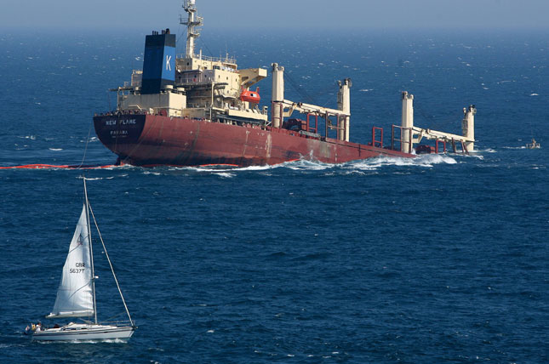
What is agility in Software Development?
Agile: An Overview
http://mediagallery.usatoday.com/New+Flame

Slide 10
Motivation
What is the “Software crisis”?
Software development inefficient
Software does not meet requirements
Projects over time/budget
Projects were unmanageable and software unmaintainable
What can be done about it?
Software Engineering
Application of engineering to Software
Systematic, disciplined, quantifiable approach to the development, operation, and maintenance of software
Assure quality of process and product

Slide 11
?
Do you know examples of
Systematic, disciplined, quantifiable approaches to the development, operation, and maintenance of software?
Applying engineering to software?

Slide 12

Where are we coming from?
Requirements
Design
Programming
Test
http://commons.wikimedia.org/wiki/File:Waterfall_katoomba.JPG

Slide 13
Systematic sequential development
Requirements
Design
Programming
Test
Advantages
Simple
Controllable
Cost efficient
Problems
Time-to-market
What about change?

Slide 14
Towards concurrent development
Requirements
Design
Programming
Test
What can we do if time to market and robustness against late changes are more important than cost-efficiency?
Requirements
Design
Programming
Test
Time-to-market
Time-to-market

Slide 15
?
What is the consequence of concurrent development?
(hint: why are concurrent tasks depicted longer than sequential tasks?)
What has this to do with agile?
What do you know about agile?

Slide 16
Iteration Models
System requirements always evolve during a project
Iterations are part of larger development projects
Iterations can be applied to any generic development process model

Slide 17
Incremental delivery
Define outline requirements
Assign requirements to increments
Design system architecture
Develop system increment
System incomplete
Validate increment
Validate system
Integrate increment
Final delivery

Slide 18
Incremental delivery
Customer value can be delivered with each increment so system functionality is early available for customer’s feedback
Early increments act as prototype to help elicit requirements for later increments
Reduced risk of project failure
The highest priority system services tend to receive the most testing

